Slide 1

First page
:username
:password
Login
auto
Create

Slide 2

Logged in as Player
Matches
Tournament
Matches
Follow
26/08-16 - 14.00
Holte vs Lyngby (x – x)
More info
27/08-16 – 15.00
Rødovre vs Lyngby (x – x)
More info
27/08-16 – 18.00
Køge vs Rødovre (x – x)
Referee
More info
28/08-16 – 08.00
Greve vs Lyngby (x – x)
More info
More

Slide 3
Logged in
Tournament
Tournament
Matches
Follow
Weekend Stævne
U16
Serie 1

Slide 4
Logged in
Tournament
Tournament
Matches
Follow
Weekend Stævne
Team #loss #win #score
-------------------------------------
1. Lyngby 5 10 85
2. Holte 7 8 65
3. Rødovre 8 7 60
4. Køge 9 6 55
Matches
------------------------------------
Rødovre vs Holte 2-0
Lyngby vs Køge 2-1
Rødovre vs Lyngby 2-0
Holte vs Køge 2-1
Rødovre vs Holte 0-0
Lyngby vs Køge 0-0

Slide 5
Logged in
Follow
Tournament
Matches
Follow
Caroline Rasmussen
28/08-16
Holte vs LGV (25–12)
Not
Implemented
Benjamin Rasmussen
25/06-15
Rødovre vs LGV (4–28)

Slide 6

Logged in as (Player)
Matches
More info
Tournament
Matches
Follow
Holte vs Lyngby (x – x)
28/08-16 (tomorrow)
Lyngby Bk
Adress: lundtoftevej 23
zip: 2800, Lyngby
Participants
Tournament
Stream
Older

Slide 7
Logged in as Player
Matches
Match info
Particpants
Tournament
Matches
Follow
Participanst
Lyngby vs Holte
No. Name. License-Year
5 Karsten Bo xxxxxx-95
4 Andreas V. xxxxxx-95
11 Lars J. xxxxxx-95
13 Gunner H. xxxxxx-95
19 Birger V. xxxxxx-95
25 Emil V. xxxxxx-96
31 Andreas K. xxxxxx-95
82 sadsa V. xxxxxx-95
15 asdasdas V. xxxxxx-94
61 Andreas V. xxxxxx-95
Back

Slide 8
Logged in as Player
Matches
More info
Stream
Tournament
Matches
Follow
Www.youtube.com/stream1

Slide 9
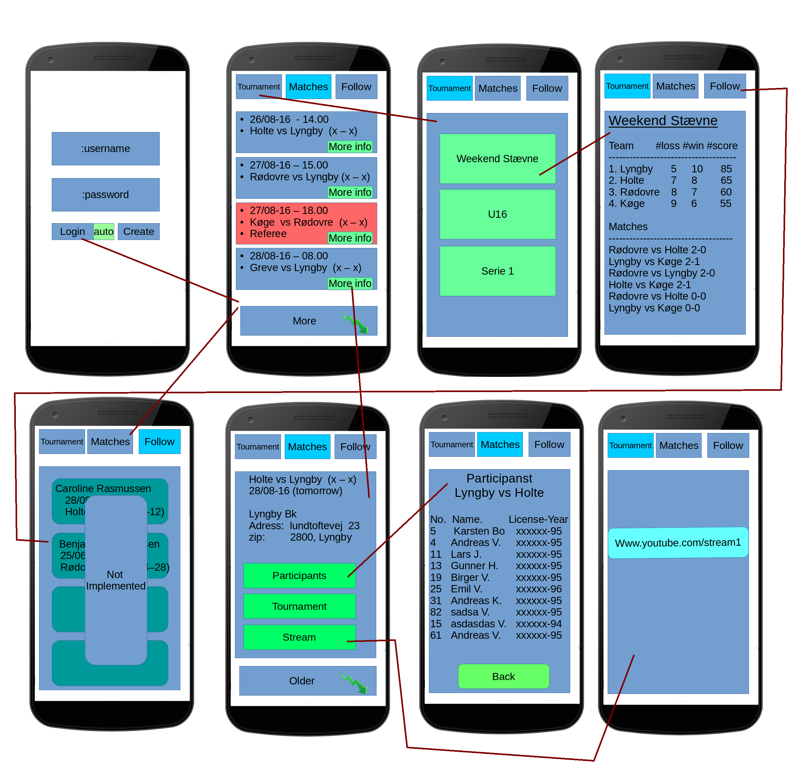
Overview

